Slide 1



Slide 4
Logistic
Logistic
Credits
Credits
ORDER NOW
ORDER NOW
ORDER NOW
Yes
Yes
No
No
Acept
Acept

Slide 5



TRANSPORT
TRANSPORT
SERVICE
SERVICE
MINIMUN RATE
MINIMUN RATE
TRUCKLOGISTIC
$20.19
$20.19
$12.98
$12.98
$33.07
$33.07
ORDER NOW
ORDER NOW

Slide 6




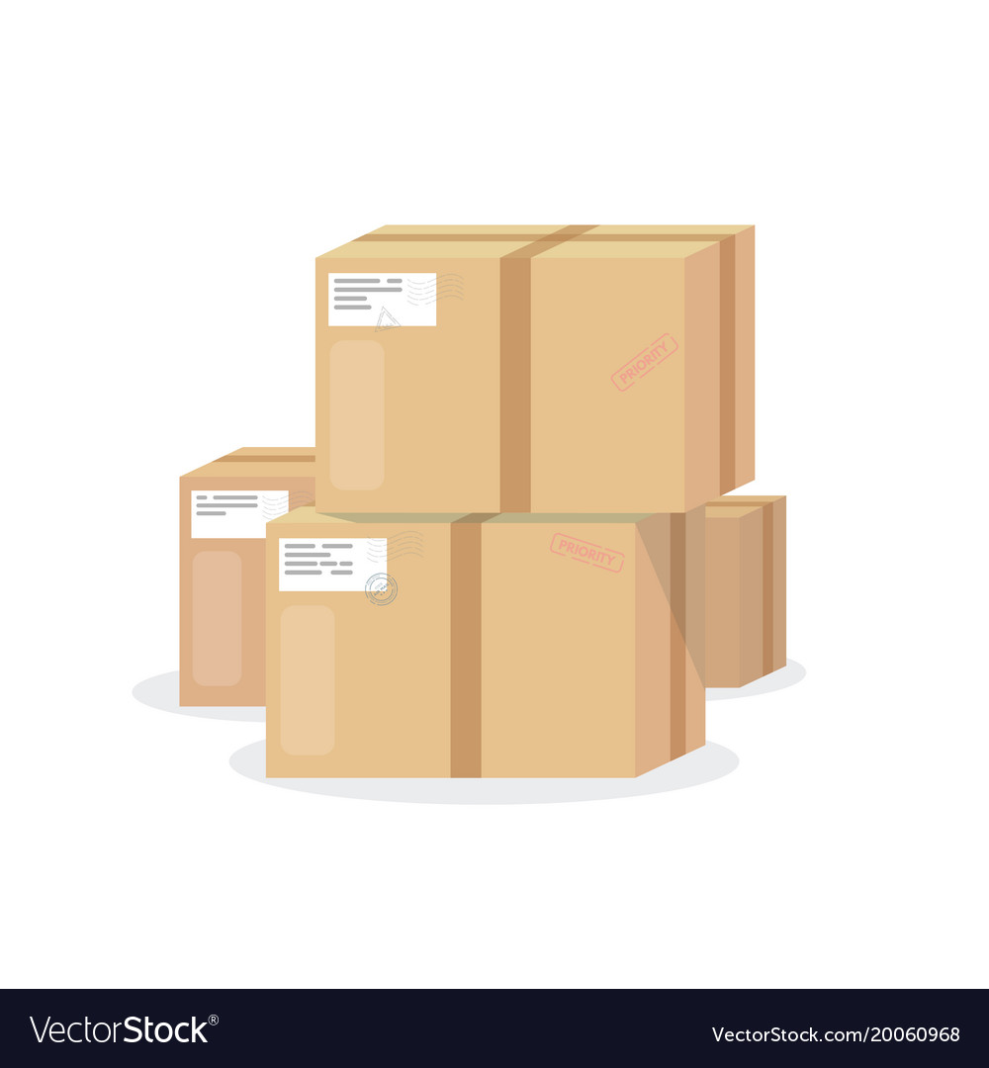




Slide 7
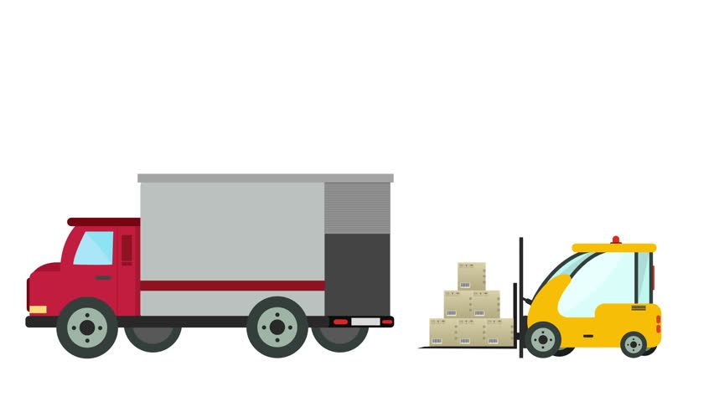
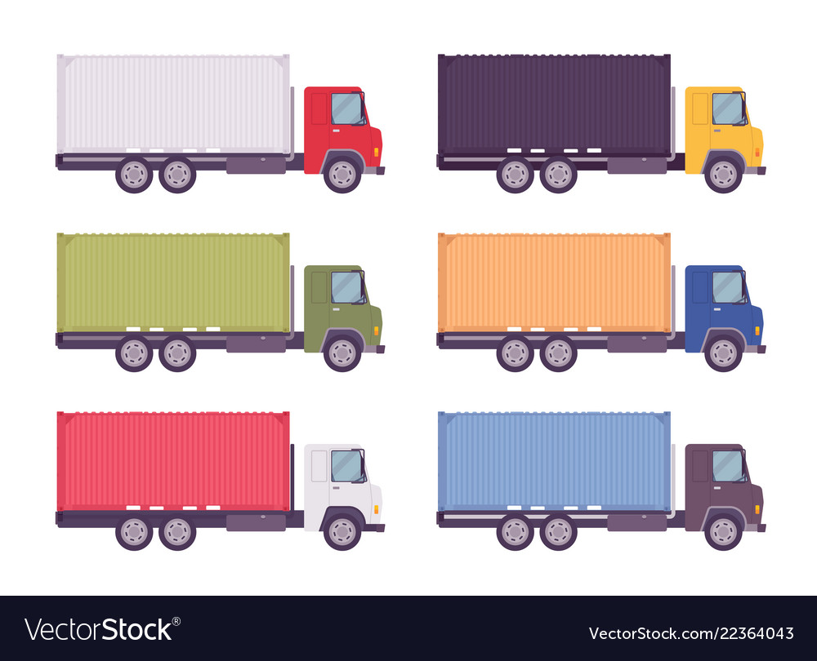






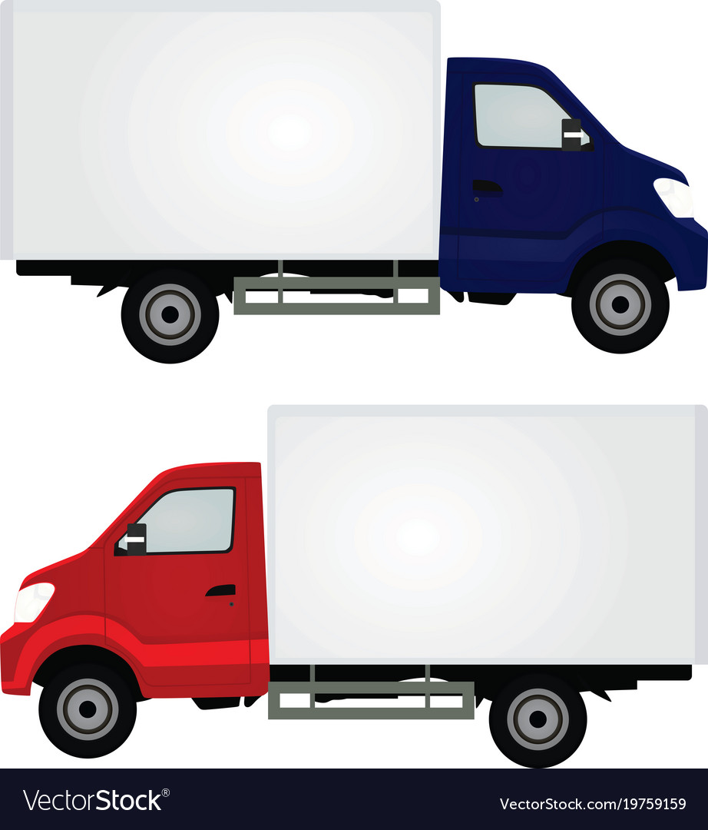
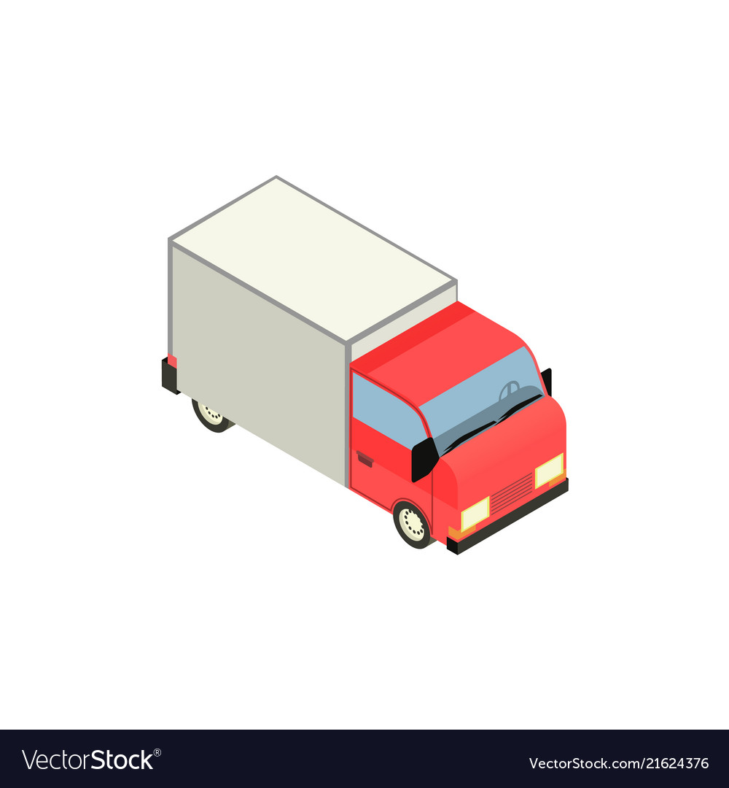


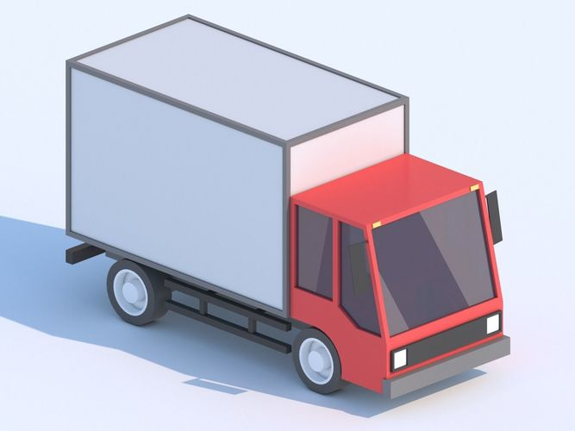

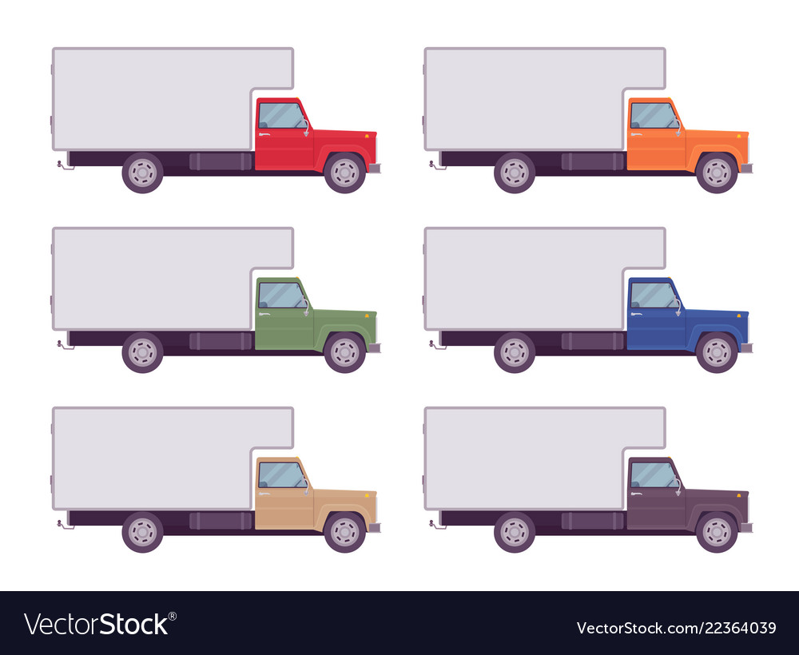
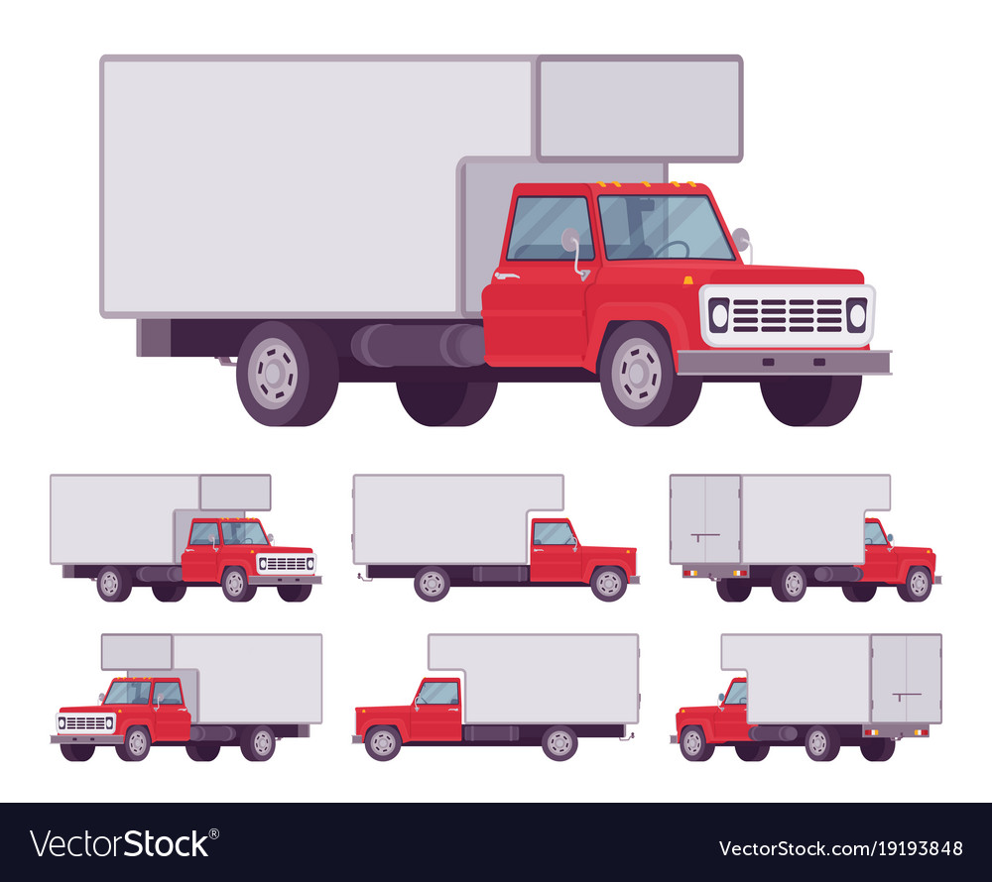
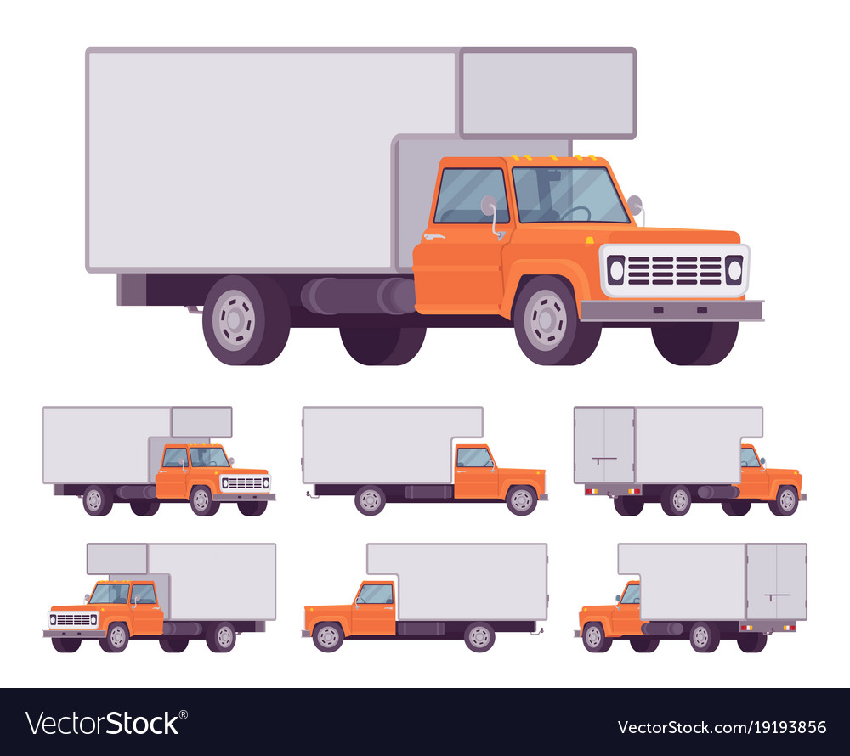
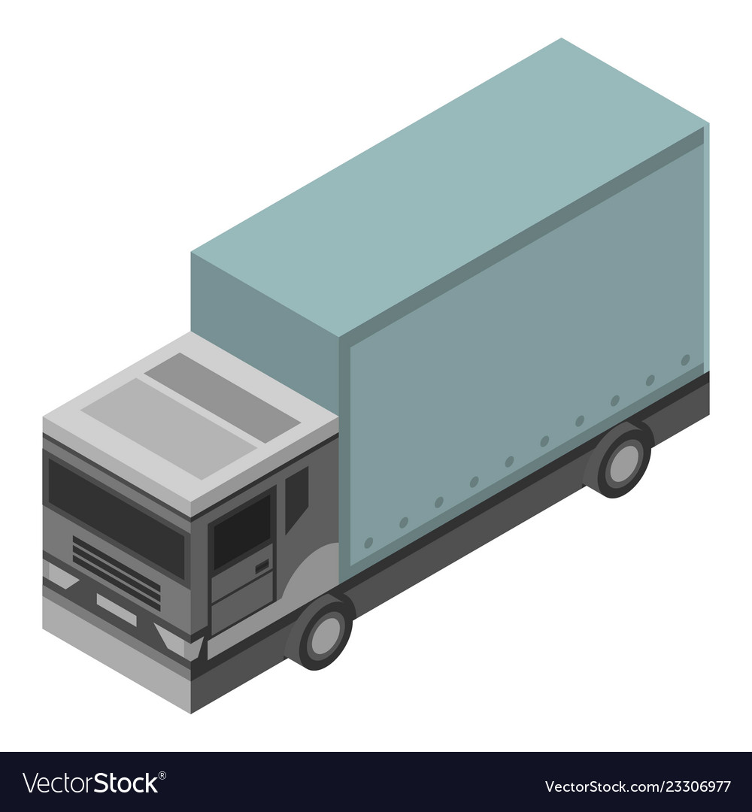

Slide 8



Slide 9
